Slide 1

TEAM 5 Cody Cass | Stephanie Nunley | Jonathan Terry

Slide 2
What is our mission?
To Connect services between multiple artist types:
Musicians | Photographers | Videographers | Graphic Designers | Management
We achieve this by hosting services on a hub platform so that users
are able to have a “One Stop Shop” experience.

Slide 3
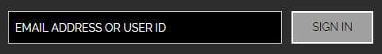
How does this work for the user?
- Sign Up Via Email or Create a User ID -
Choose User Type:
Musician | Manager | Photographer | Videographer | Graphic Designer
Create Bio:
Upload Professional Content:
Music | Videos | Photos
Update Services Offered:
Price | Availability | Travel
Update Personal Information Within Profile

Slide 4

UPGRADE PACKAGE
Allow users to store more content and grants access to BADGES
Allow users the ability to be ranked and showcased based on TAGS
BADGES
Collect BADGES to increase ranking on the Charts
Members can search Top Users by BADGE/TAG rankings

Slide 5
DATA FLOW CHART

Slide 6
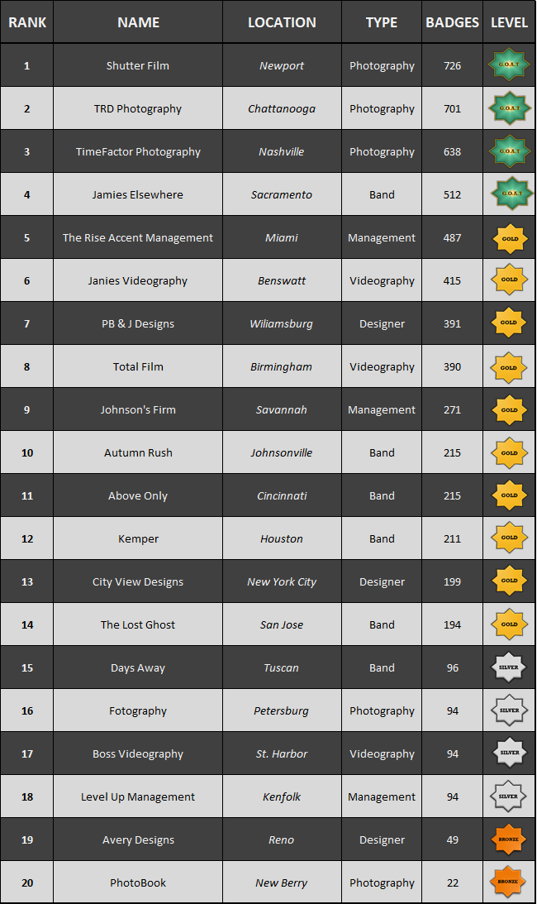
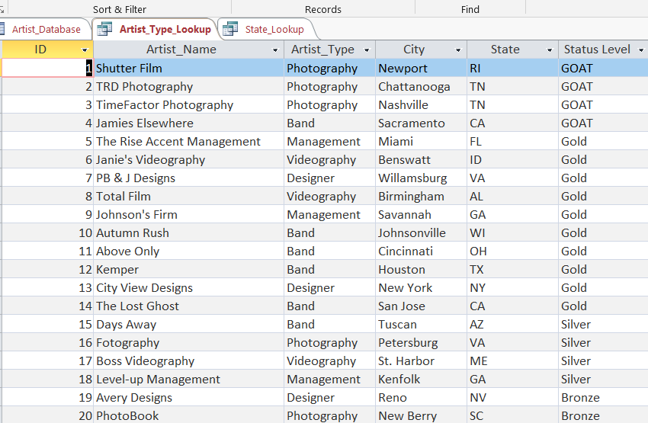
Database

Slide 7
Employment Opportunities

Slide 8
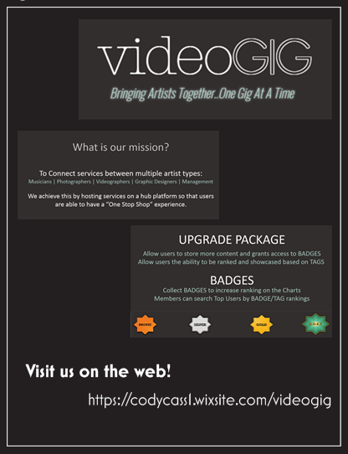


Marketing

Slide 9




Advertisement
Business Ads will be accepted and based on profile specific types
Ads will NOT include Data from users nor access to private content
We will have 2 premiums for Advertisements: Regional and National

Slide 10
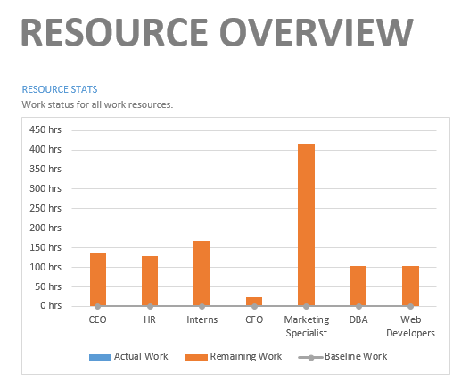
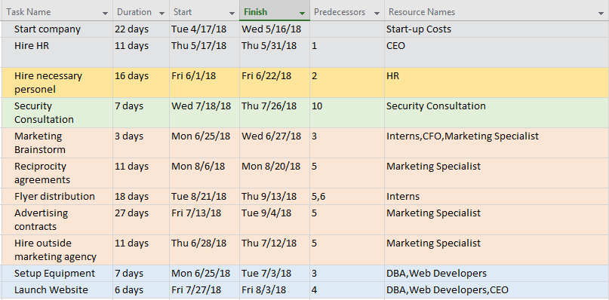
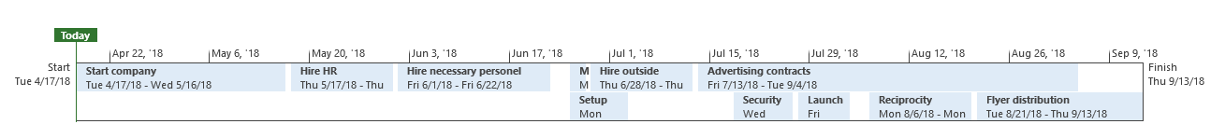
Timeline

Slide 11
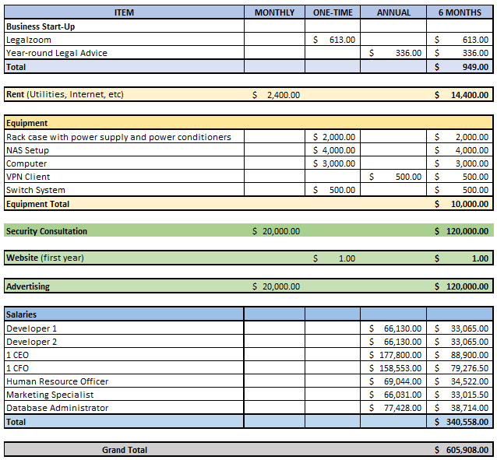
Budget

Slide 12

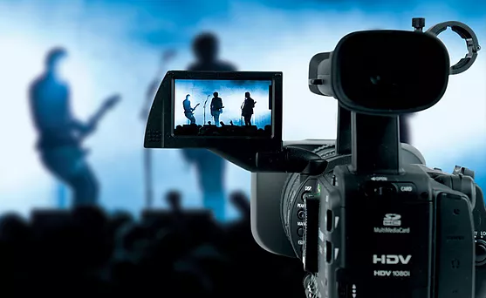
TEAM 5 Cody Cass | Stephanie Nunley | Jonathan Terry

